Slide 1
Employee Data Analysis using Excel
STUDENT NAME: CLEMENT IMMANUEL C C
REGISTER NO: 312214509/ 249CB55888950B4869B49BD33642336C
DEPARTMENT: B.COM COMPUTER APPLICATION
COLLEGE: ST.THOMAS COLLEGE OF ARTS & SCIENCE

Slide 2
PROJECT TITLE Using Pivot Tables For Employee Turnover Analysis

Slide 3


AGENDA
Problem Statement
Project Overview
End Users
Our Solution and Proposition
Dataset Description
Modelling Approach
Results and Discussion
Conclusion
3/21/2024 Annual Review

Slide 4

PROBLEM STATEMENT
* The Human Resources department is experiencing challenges in understanding and managing
* employee turnover within the organization. Current methods of data analysis are insufficient in identifying key trends and patterns related to turnover, such as which departments, job roles, or demographic groups are most affected.
* This lack of insight hampers the ability to develop targeted retention strategies.

Slide 5

PROJECT OVERVIEW
* Employee turnover is a critical issue for organizations, affecting productivity, morale, and financial performance.
* Understanding the factors contributing to turnover is essential for developing effective retention strategies.
* This project aims to leverage pivot tables to analyze employee turnover data, providing insights into patterns and trends that can inform decision-making within the Human Resources (HR) department.
* This is the data using pivot tables for employee turnover analysis

Slide 6

WHO ARE THE END USERS?
Human Resources (HR) Team:
• HR Analysts: Responsible for conducting the analysis and presenting the findings.
• HR Managers: Interested in understanding the turnover trends to implement strategic initiatives.
HR Directors and Executives:
• HR Directors: Oversee the overall HR strategy and need the insights to align turnover management with organizational goals.
• Chief HR Officer (CHRO): Utilizes the data to guide company-wide HR policies and strategies.
Department Heads and Managers:
• Managers: Need to understand turnover trends within their teams to address specific issues and improve retention.
• Department Heads: Use the analysis to make decisions related to staffing, training, and employee engagement.
Executives and Senior Management:
• CEO/CFO: Interested in the financial and

Slide 7

OUR SOLUTION AND ITS VALUE PROPOSITION
* Streamlined Data Organization: Pivot tables allow you to consolidate and organize large volumes of HR data efficiently. - Simplifies the process of categorizing turnover data by departments, roles, tenure, and other key metrics.
* Dynamic Analysis Capabilities: Enables easy filtering and sorting of data to identify patterns, trends, and anomalies in employee turnover. - Allows for quick adjustments and comparisons, such as turnover rates by department, time period, or employee demographics.
* Real-Time Insights and Reporting: Facilitates the creation of real-time, up-to-date reports that can be easily shared with stakeholders. - Empowers HR teams to make data-driven decisions quickly by visualizing turnover data in various formats (e.g., charts, graphs).
* Cost-Effective Solution: Uses widely available tools (Excel, Google Sheets) that require minimal additional investment. - Reduces the need for expensive third-party analytics software or consultants.

Slide 8
Dataset Description
* Employee= KAGGLE
* 26- feature
* 9 -features
* Emp Id- Number
* Name Text
* Emp- Type
* Current Employee Rating- Number
* Gender- Male Female
* Employee Rating -Number

Slide 9

THE "WOW" IN OUR SOLUTION
=IFS(Z8>=5,”VERY HIGH”,Z8>=4,”HIGH”,Z8>=3,”MED”,TRUE,”LOW”)
3/21/2024 Annual Review
9

Slide 10
MODELLING
* Employee ID: A unique identifier for each employee.
* Department: The department the employee belongs to.
* Hire Date: The date the employee was hired.
* Termination Date: The date the employee left the company, if applicable.
* Tenure: The length of time the employee worked at the company.
* Reason for Leaving: The reason provided for leaving (e.g., resignation, termination, retirement).
10

Slide 11
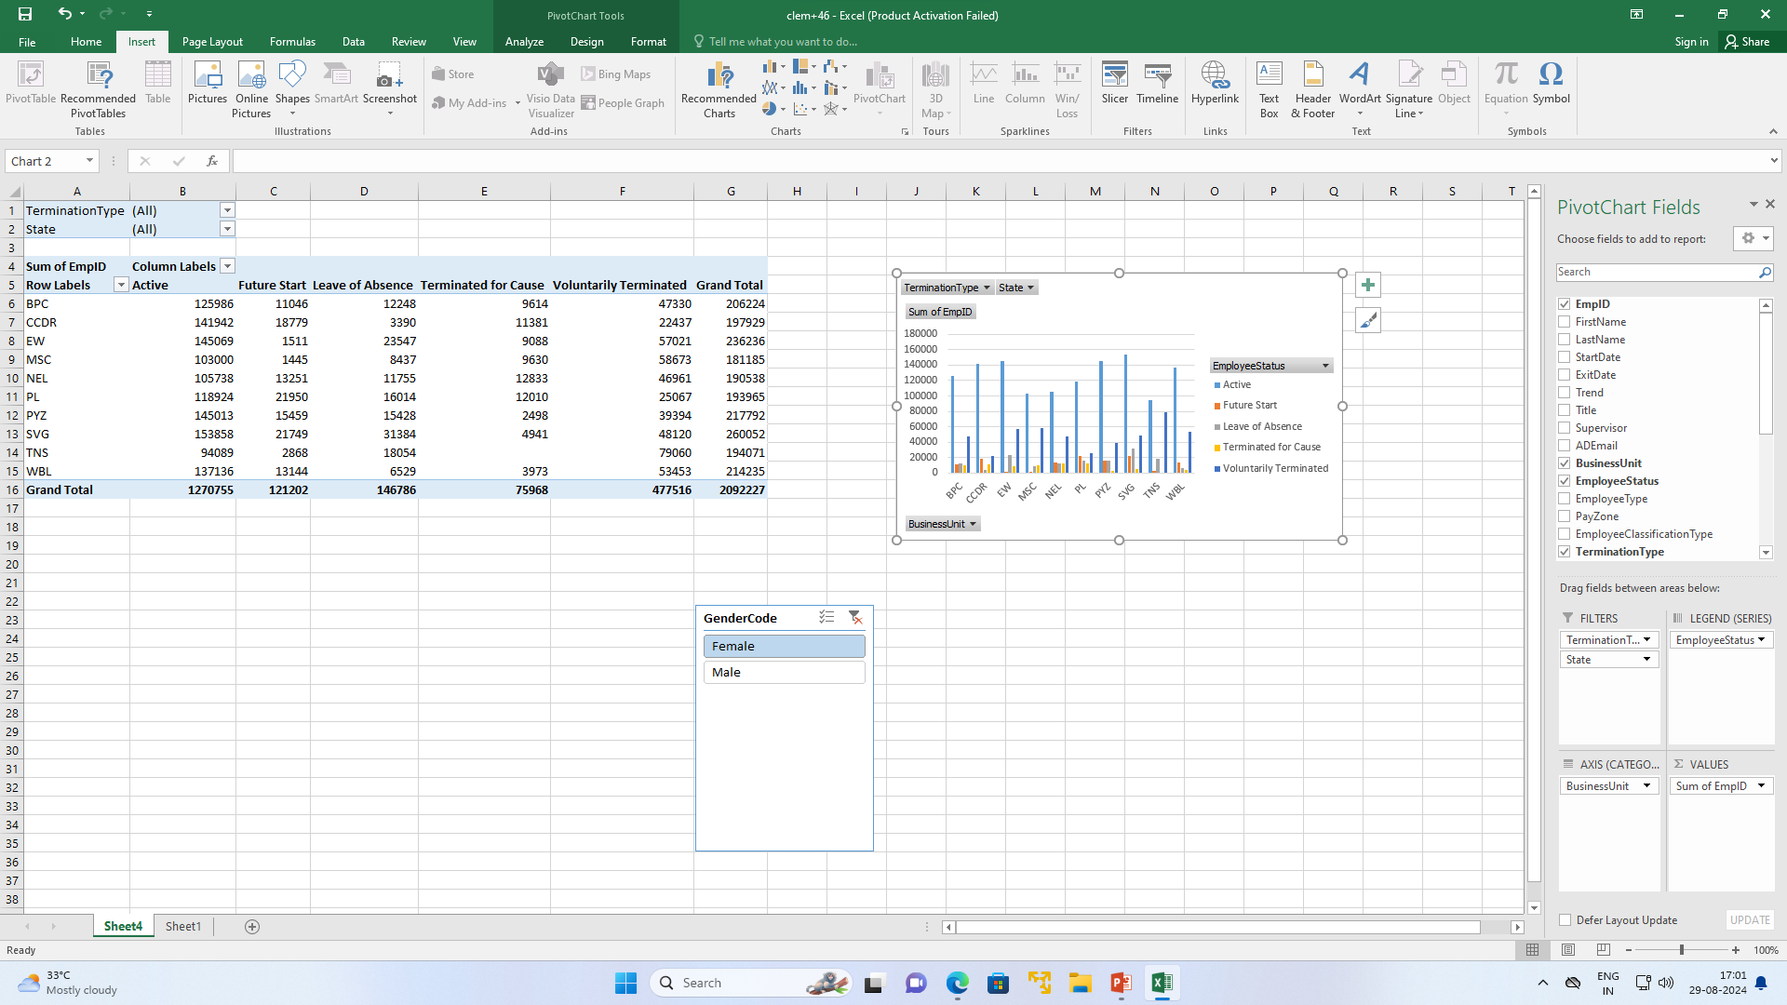
RESULTS
11

Slide 12
RESULTS
Female
Male

Slide 13
conclusion
* In conclusion, pivot tables are a powerful tool for analyzing employee turnover, providing a clear and concise way to summarize and interpret complex data.
* They allow for efficient organization and visualization of turnover metrics, such as rates by department, reasons for leaving, and tenure trends.
* By leveraging pivot tables, organizations can identify key patterns and insights that inform strategic decisions on improving employee retention, addressing departmental issues, and enhancing overall workforce stability.
* This analytical approach ultimately supports data-driven decision-making, helping to create a more resilient and effective organization.

